Slide 1
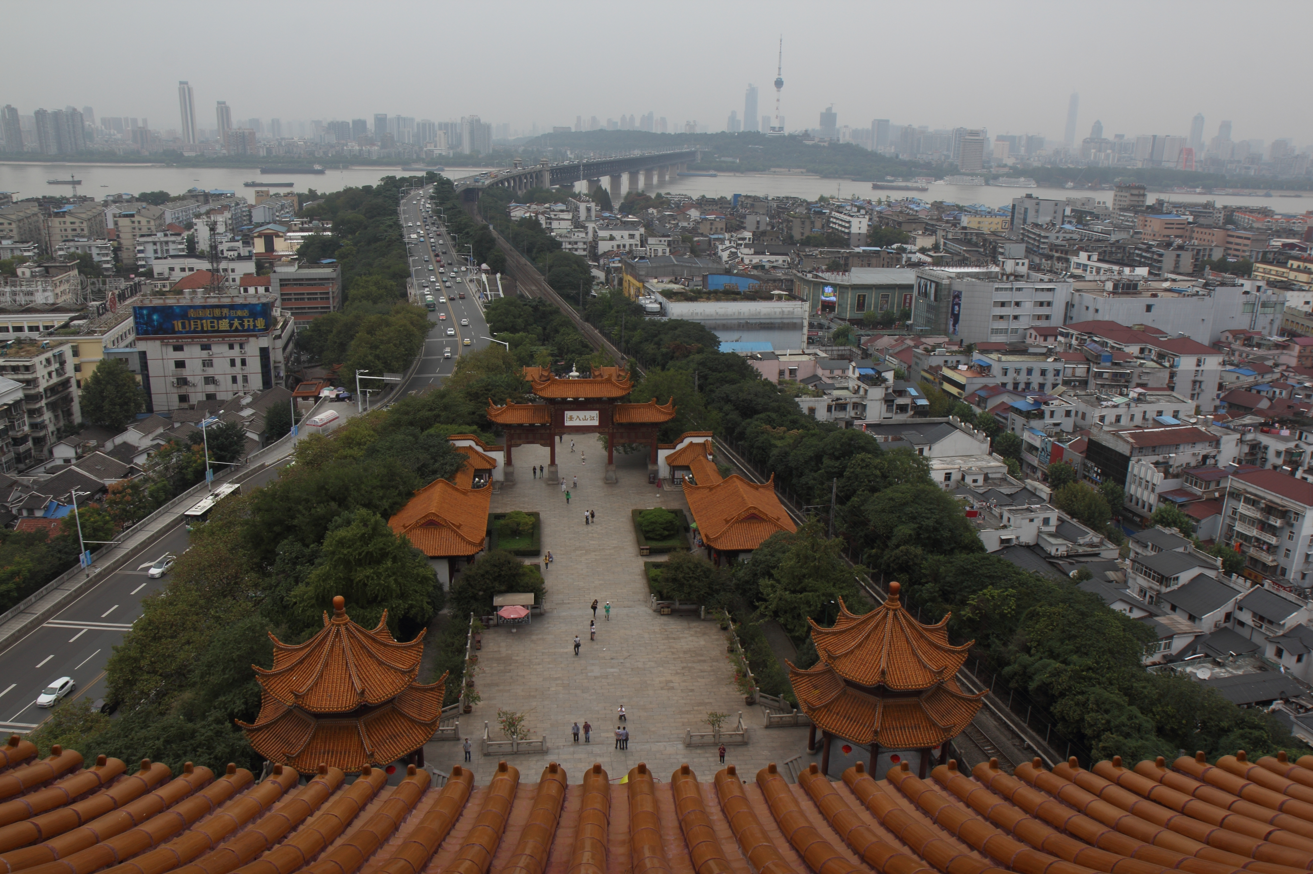
AMPT Part-I
Zi-Wei Lin (林子威)
Department of Physics
East Carolina University
Greenville, NC

Slide 2
Outline
Part 1:
Motivation
Structure of the AMPT model
Individual components of AMPT
Part 2:
Maintenance and past developments
Selected results based on AMPT
Challenges & opportunities

Slide 3
For comprehensive simulations of high energy heavy ion collisions
We need:
Initial particle/energy production
Pre-equilibrium interactions:
equilibration, thermalization, initial flow
Space-time evolution of QGP
Hadronization
/QCD phase transition
Hadronic interactions
Choices:
Soft+hard model (& string melting),
CGC, pQCD, ...
Parton cascade (ZPC, MPC, BAMPS),
CGC, AdS/CFT, …
Parton cascade (ZPC, MPC, BAMPS),
(ideal, viscous, anisotropic) hydrodynamics, ...
Quark coalescence/parton recombination, string fragmentation, Cooper-Frye, statistical hadronization, independent fragmentation, rate equations, ...
Hadron cascade (ART, RQMD, UrQMD, ...), thermal model (w/ freezeout temperatures), …
The AMPT model currently includes the green components for each phase.

Slide 4
Structure of AMPT v1.xx (Default version)
A+B
HIJING1.0:
minijet partons (hard), excited strings (soft), spectator nucleons
Generate parton space-time
ZPC (parton cascade)
Partons freeze out
Hadronization (Lund string fragmentation)
Extended ART (hadron cascade)
Hadrons freeze out (at a global cut-off time);
then strong-decay all remaining resonances
Final particle spectra

Slide 5
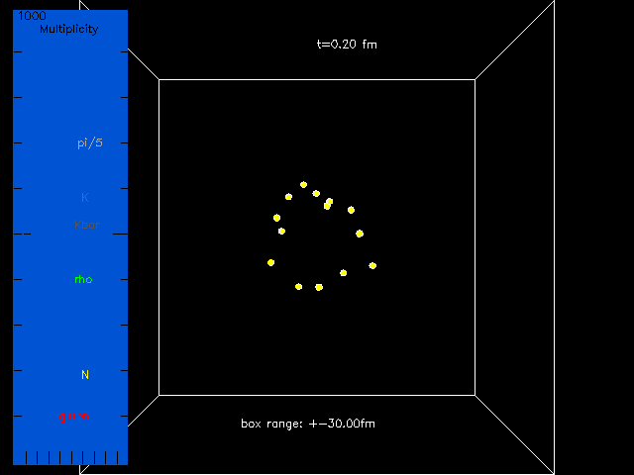

A central Au+Au event at 200AGeV from the Default AMPT model
60fm-long box;
shows only
formed particles.
◉
Beam axis
1st frame:
right after the
primary collision,
only spectator
nucleons are formed.
At middle right:
a rho decays
at 7.0 fm/c.
At lower right:
a K*bar is produced
at 16.6 fm/c
&
vanishes at 20.8fm/c.

Slide 6
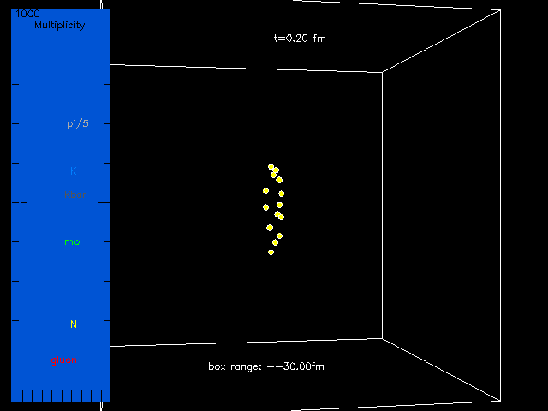

The same Au+Au event at 200AGeV from the Default AMPT model
Beam axes
Dynamics is
time-dilated
at large rapidities
Notes:
Color: gluon (2 red), q (2 red), qbar (5 cyan);
pi (15 gray), k (11 light blue), kbar (14 dark gray), K*/K*bar (6 magenta), rho (3 deep green), omega/phi/eta/allOthers (1 white),
p/n (7 yellow), pbar/nbar (12 violet), Delta/N*/Lambda/Sigma & bar (12 violet).

Slide 7
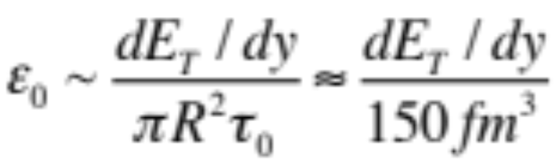
String Melting version of AMPT
Estimate the initial energy density in AA collisions:
~ 2.5 6 20 GeV/fm³
SPS RHIC LHC
>>critical energy density
for QCD phase transition:
ε_{c} ~ O(1/2) GeV/fm³
Nuclear radius
Proper formation time, taken as 1 fm/c
➔At high-enough energies,
hadronic matter such as strings cannot exist early on,
they should be represented by a high density partonic matter:
➔ the string melting version of AMPT ZWL & Ko, PRC65

Slide 8
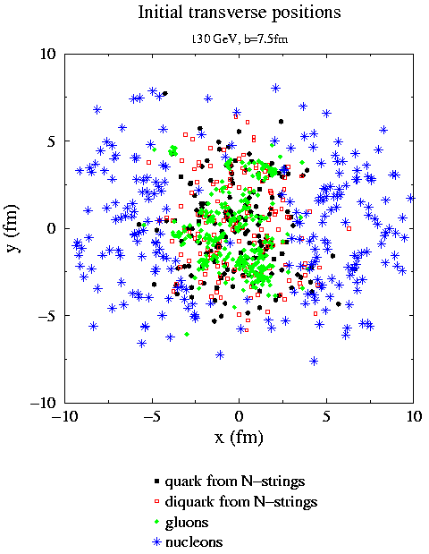
String Melting version of AMPT
Soft strings are
in the high density overlap area,
but not in parton cascade in default model.
With String Melting:
we convert strings into partonic matter.
Initial condition in default AMPT:
soft (strings) & hard (minijets)
◉
Beam axis
minijets
Notes:
For Au+Au @ 200A GeV: minijets account for ~ 1/3 total E_{T}

Slide 9
Structure of AMPT v2.xx (String Melting version)
A+B
HIJING1.0:
minijet partons (hard), excited strings (soft), spectator nucleons
Generate parton space-time
Strings melt to q & qbar via intermediate hadrons
ZPC (parton cascade)
Partons freeze out
Hadronization (Quark Coalescence)
Extended ART (hadron cascade)
Hadrons freeze out (at a global cut-off time);
then strong-decay all remaining resonances
Final particle spectra

Slide 10
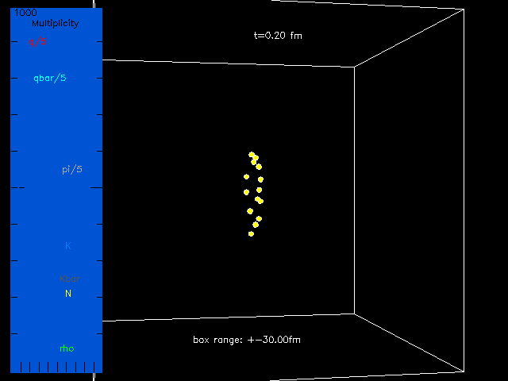

The same Au+Au event at 200AGeV from the String Melting AMPT
σ_{p}=3mb
60fm-long box
Beam axes
E.g. middle region
(near mid-rapidity):
coalescence of
q (red) and
qbar (cyan)
Notes:
Color: gluon (2 red), q (2 red), qbar (5 cyan); pi (15 gray), k (11 light blue), kbar (14 dark gray), K*/K*bar (6 magenta), rho (3 deep green), omega/phi/eta/allOthers (1 white), p/n (7 yellow), pbar/nbar (12 violet), Delta/N*/Lambda/Sigma & bar (12 violet).
% Look at bottom middle: an anti-strange meson (turns out to be K*bar) is created ~3.8 fm/c, then decayed to a Kbar and a pion at ~10.6 fm/c.
You can see rho decays on middle to left, a white object decays to pions at top middle.

Slide 11
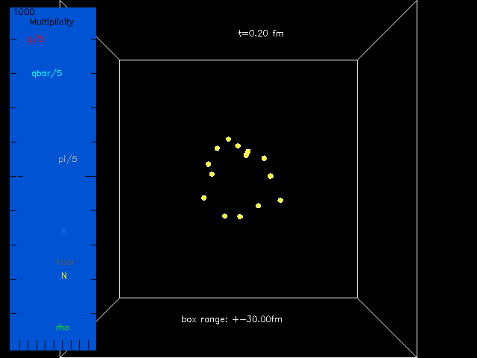

A central Au+Au event at 200AGeV from the String Melting AMPT
View on
the beam axis
Notes:
Look at bottom middle: an anti-strange meson (turns out to be K*bar) is created ~3.8 fm/c, then decayed to a Kbar and a pion at ~10.6 fm/c.
Note: K* width=51 MeV, K*bar is deep green while Kbar is light green here.
You can see rho decays on middle to left, a white object decays to pions at top middle.

Slide 12
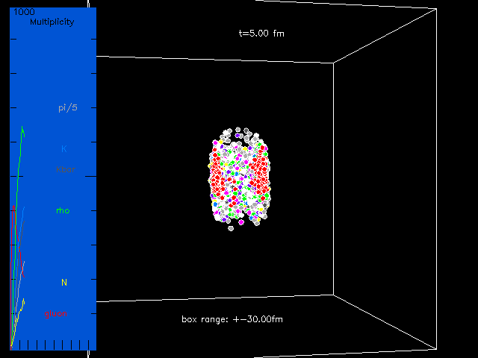
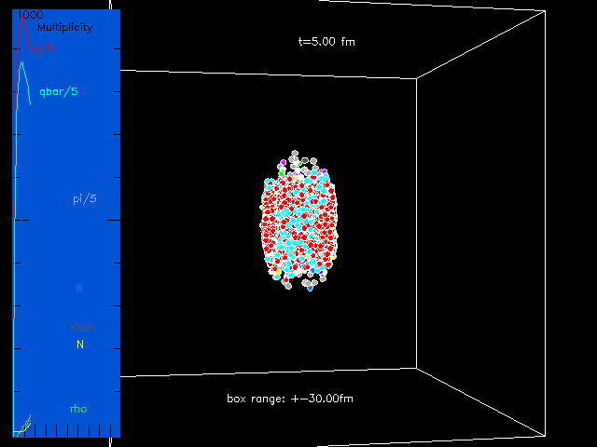
Compare the same event:
Default AMPT vs String Melting AMPT
at t=5 fm/c:
With String Melting:
many more partons,
parton stage dominates;
hadron stage starts much later
Beam axes

Slide 13
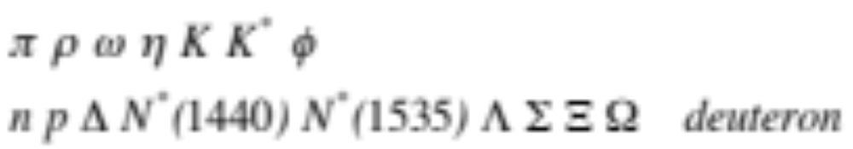

Individual components of AMPT
HIJING1.0 Two component model (soft strings + hard minijets)
ZPC parton cascade (elastic collisions only)
Hadronization Lund string fragmentation (Default AMPT)
or
Quark coalescence (String Melting AMPT)
Extended ART Hadron cascade,
including secondary interactions for
All other particles with PYTHIA flavor codes have no secondary interactions,
but they can be produced (from HIJING, string fragmentation, or quark coalescence),
e.g.
Each hadron has an explicit isospin/charge.
K_{S}⁰ and K_{L}⁰ are also produced at the end of hadron cascade.
Notes:
Hadrons formed via coalescence do not include eta’ in pseudoscalar mesons, Sigma* or Xi* in decuplet baryons.

Slide 14
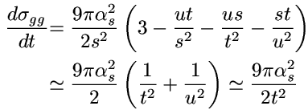

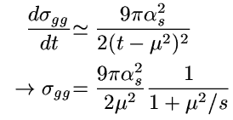
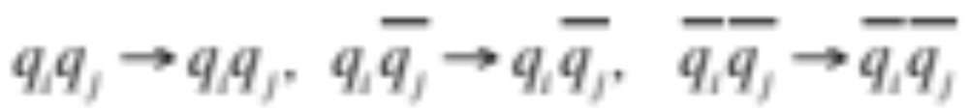
Individual components of AMPT: parton cascade
Cross section
based on
in leading-order pQCD:
A screening mass μ
regulates the divergence:
Elastic collisions only:
in Default AMPT, massless gluons.
in String Melting AMPT,
but using the same gg cross section;
using current quark masses: u 5.6MeV, d 9.9MeV, s 199MeV, …
Notes:
The screening mass should be medium-generated, but currently it is treated as a parameter.
Since the scattering angle ranges from 0 to π/2 for identical particles,
one then has 9pi alpha^2/(2t^2) if the scattering angle is between 0 and π.

Slide 15
Individual components: hadronization in Default AMPT
HIJING produces
string1 =string1'+ minijets1
…
stringN =stringN'+ minijetsN
stringN+1
…
minijets1*
…
minijetsN*
ZPC
string1* =string1'+minijets1*
…
stringN* =stringN'+minijetsN*
stringN+1
…
Apply Lund string fragmentation to all strings:
Minijet partons recombine with the original string':
to ensure success of string fragmentation,
e.g. to avoid fractional total charge for a string

Slide 16
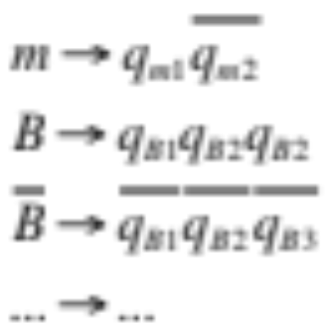
Individual components: initial condition from String Melting
String Melting converts strings into quarks/antiquarks:
HIJING:
Excited string/
wounded nucleon
Lund
fragmentation
Decomposition according to constituent quark structure
Include fluctuations
of nucleon positions
from Monte Carlo Glauber
String Melting introduces
additional fluctuations to the initial parton matter:
through random nature of minijet production
and string fragmentation,
longitudinal correlation of partons
from the same string (~flux tube)
Notes:
Projectile & target spectators remain nucleons and are not decomposed.

Slide 17
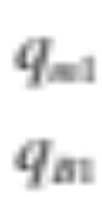
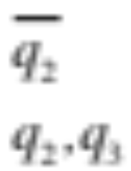
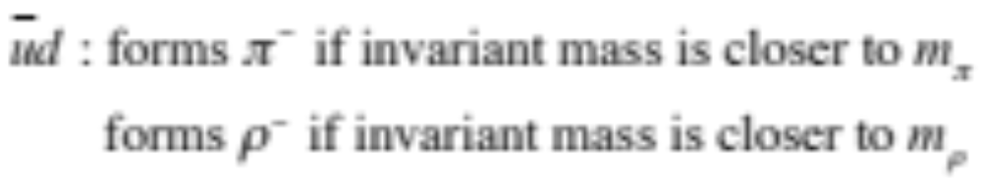
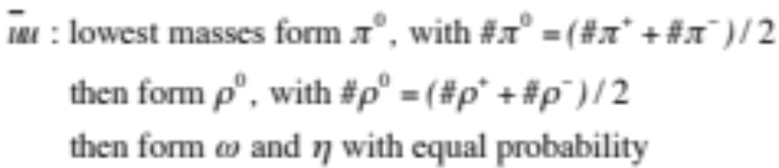
Individual components: quark coalescence in String Melting
Current algorithm for the dynamical quark coalescence (using large dr & dp):
A parton finds the closest partner in space to form a hadron:
finds the closest forms a meson
finds the closest forms a baryon
…
Original partner from the parent hadron is used if no closer partner.
Then determine flavor of the formed hadron,
for example:
Notes:
A parton will form a meson if the parton occupying its original place comes from the melting of a meson;
this is to ensure that coalescence will always go through for the parton system.
Original partner from the parent hadron is used if no closer partner within the given dr and dp.

Slide 18



Individual components of AMPT: hadron cascade
Based on: the ART model Li & Ko, PRC52
interactions added Song, Li & Ko, NPA646
annhilation, K⁰ productions Zhang et al, PRC61
mesons, explicit K* ZWL et al, PRC64, NPA698
η interactions ZWL & Ko,PRC65
φ interactions Pal, Ko & ZWL, NPA707
Multi-strange interactions (Λ Σ Ξ Ω) Pal, Ko & ZWL, NPA730
Deuteron interactions Oh, ZWL & Ko, PRC80, NPA834

Slide 19

AMPT Part-II
Zi-Wei Lin (林子威)
Department of Physics
East Carolina University
Greenville, NC

Slide 20
Outline
Part 1:
Motivation
Structure of the AMPT model
Individual components of AMPT
Part 2:
Maintenance and developments
Selected results based on AMPT
Challenges & opportunities

Slide 21
Maintenance and developments of AMPT: public access
First public release of AMPT source codes: ~ April 2004.
Detailed physics descriptions in the long paper:
ZWL, Ko, Li, Zhang & Pal, PRC 72, 064901 (2005).
"Official" versions v1.11/v2.11 (2004) and v1.21/v2.21 (2008)
are available at
https://karman.physics.purdue.edu/OSCAR
&
http://myweb.ecu.edu/linz/ampt/
More versions, including later test (t) versions, are available at
the above ECU site:
http://myweb.ecu.edu/linz/ampt/
Notes:
Access webpage.

Slide 22
Maintenance and developments of AMPT: readme 1
Examples (from the readme file):
4/2015 test version v1.26t5/v2.26t5:
* Random seed for HIJING is modified in main.f, so that a different
random seed will always lead to a different random number sequence
(in earlier versions, an even integer leads to the same random number
sequence as the odd integer that is bigger than it by 1).
* set upper limit for gamma_s=P(s)/P(u) to 0.4 (to limit strangeness
enhancement when string tension is strongly increased due to
a very low value of parameter b in Lund symmetric splitting function
as done in arXiv:1403.6321).
8/2014 test version v1.26t4/v2.26t4:
* Fixed crash at high energies due to finite precision of function asinh(x),
where the argument of LOG() can be 0 for large negative x.

Slide 23
Maintenance and developments of AMPT: readme 4
Examples (from the readme file):
7/2009 test version v1.25t2/v2.25t2:
* added two new input values in file `input.ampt': ishadow and dshadow.
Setting ishadow=1 (when shadowing flag is on) enables users to set
dshadow (between 0.d0 & 1.d0) to get an intermediate nuclear shadowing
between no-shadowing (when dshadow=0.d0)
and the default HIJING shadowing (when dshadow=1.d0).
The above modification can be found by searching "clin-7/2009".
6/2009 test version v1.25t1/v2.25t1:
* ioscar=3 now enables the following output files in addition to
ana/parton-initial-afterPropagation.dat:
all parton collision history in ana/parton-collisionsHistory.dat,
minijet initial condition in ana/minijet-initial-beforePropagation.dat,
ana/parton-after-coalescence.dat for String Melting.
3/2009 test version v1.23/v2.23:
* Enable users to insert user-defined hadrons to the hadron cascade.

Slide 24
Maintenance and developments of AMPT: readme 5
Examples (from the readme file):
10/2008 test version v1.22/v2.22:
* Included deuteron(d) interactions in hadron cascade via d+M ↔ B+B,
also included elastic collisions of d+M and d+B.
Here M represents a meson including pi, rho, omega and eta;
and B represents a baryon including proton, neutron, Delta,
N*(1440) and N*(1535).
Anti-deuteron processes are included similarly.
Elastic collisions of d+M and d+B are also included.
The cross sections for d+π ↔ N+N are based on experimental data;
for other reactions, 4 different assumptions on their cross sections
are available
…
10/01/2008 v1.21/v2.21
…
11/30/2004 v1.11/v2.11

Slide 25
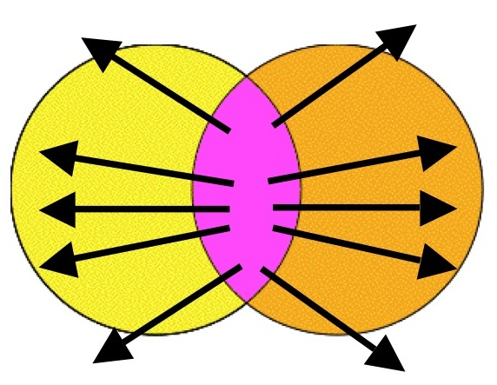
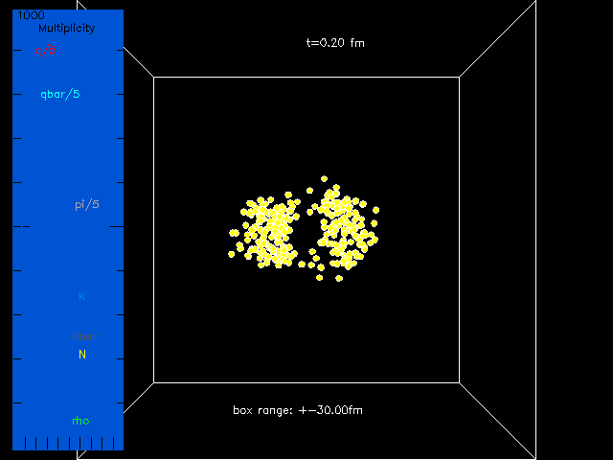

A b=10fm Au+Au event at 200AGeV from String Melting AMPT
Selected results based on AMPT: v3
Triangular flow
was discovered using AMPT:
Alver & Roland, PRC 81 (2010)
What happens in an individual event:
Simplified picture of flow
◉
Beam axis

Slide 26
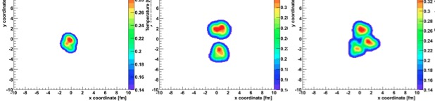
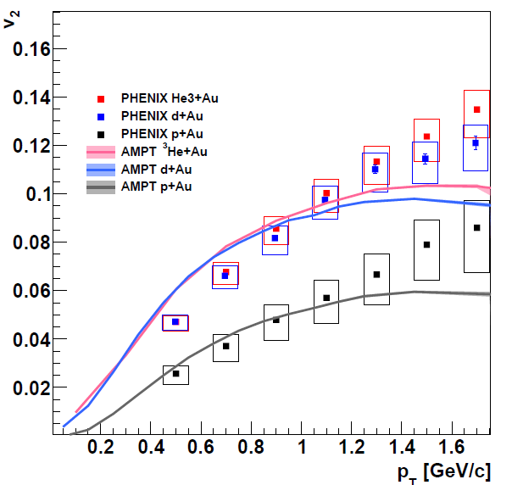
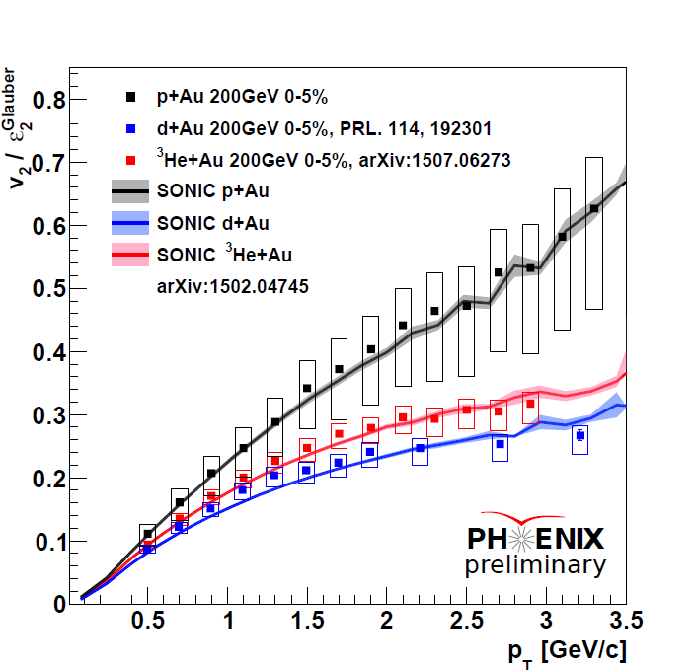
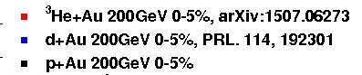
Selected results based on AMPT: small systems, longitudinal correlation
pAu, dAu, He3+Au
See J. Nagle’s talk at QM2015
Orjuela Koop et al. arXiv:1501.06880;
PHENIX, PRL 115 (2015)
Longitudinal correlation from string melting of Lund strings:
See LongGang Pang’s talk at this meeting and at QM2015

Slide 27
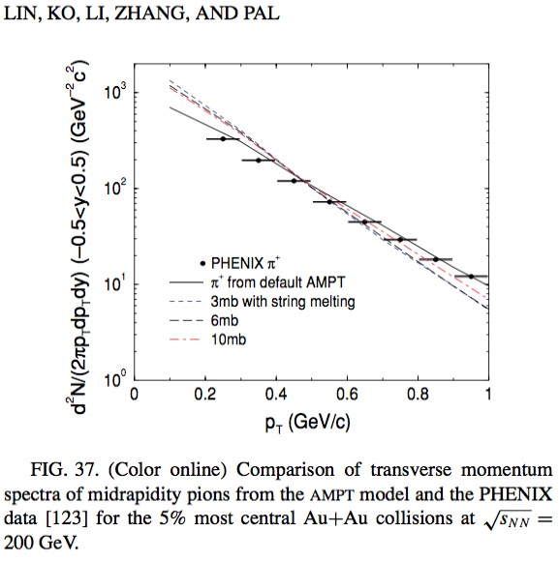
Selected results based on AMPT: new parameter set for String Melting
ZWL, PRC 90 (2014):
PRC72 (2005)
Goal: fit low-pt (<2GeV/c) π & K data on dN/dy, p_{T} –spectra & v2
in central (0-5%) and mid-central (20-30%)
200AGeV Au+Au collisions (RHIC) and 2760AGeV Pb+Pb collisions (LHC).
 | HIJING1.0 | AMPT-SM [1] | AMPT-SM in [2]
Lund string a | 0.5 | 2.2 | 0.5 0.0
Lund string b (GeV⁻²) | 0.9 | 0.5 | 0.9
α_{s} in parton cascade | N/A | 0.47 | 0.33
Parton cross section | N/A | ~ 6 mb | 1.5 mb
Model describes | pp, … | v2 & HBT not dN/dy or p_{T} | dN/dy, v2 (LHC) not p_{T}
[1] ZWL, Ko, Li, Zhang and Pal, Phys Rev C 72, 064901 (2005); etc.
[2] Xu and Ko, Phys Rev C 83, 034904 (2011).
Notes:
Also set upper limit on the strangeness quark suppression factor as 0.4.

Slide 28
Selected results based on AMPT: new parameter set for String Melting
ZWL, PRC 90 (2014): parameter set reasonably reproduced
low-pt (<2GeV/c) π & K data on dN/dy, p_{T} –spectra & v2
in central (0-5%) and mid-central (20-30%)
200AGeV Au+Au collisions (RHIC) and 2760AGeV Pb+Pb collisions (LHC)
 | HIJING1.0 | AMPT-SM [1] | AMPT-SM in [2] | AMPT-SM in [3]
Lund string a | 0.5 | 2.2 | 0.5 | 0.55 for RHIC, 0.30 for LHC
Lund string b (GeV⁻²) | 0.9 | 0.5 | 0.9 | 0.15 *
α_{s} in parton cascade | N/A | 0.47 | 0.33 | 0.33
Parton cross section | N/A | ~ 6 mb | 1.5 mb | 3 mb
Model describes | pp, … | v2 & HBT not dN/dy or p_{T} | dN/dy, v2 (LHC) not p_{T} | dN/dy, p_{T} & v2 (π,K@RHIC, LHC)
[1] ZWL, Ko, Li, Zhang and Pal, Phys Rev C 72, 064901 (2005); etc.
[2] Xu and Ko, Phys Rev C 83, 034904 (2011).
[3] ZWL, Phys Rev C 90, 014904 (2014). * also limit P(s)/P(q) to 0.4
Notes:
Also set upper limit on the strangeness quark suppression factor as 0.4.

Slide 29
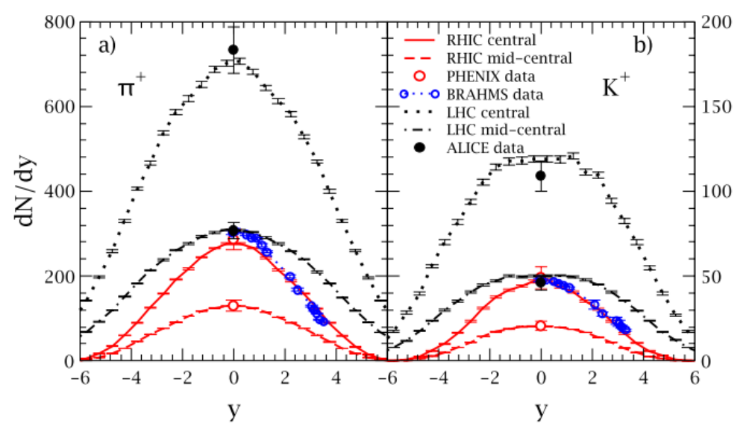
Selected results based on AMPT: new parameter set for String Melting
dN/dy of π & K:
ZWL, PRC 90 (2014).

Slide 30
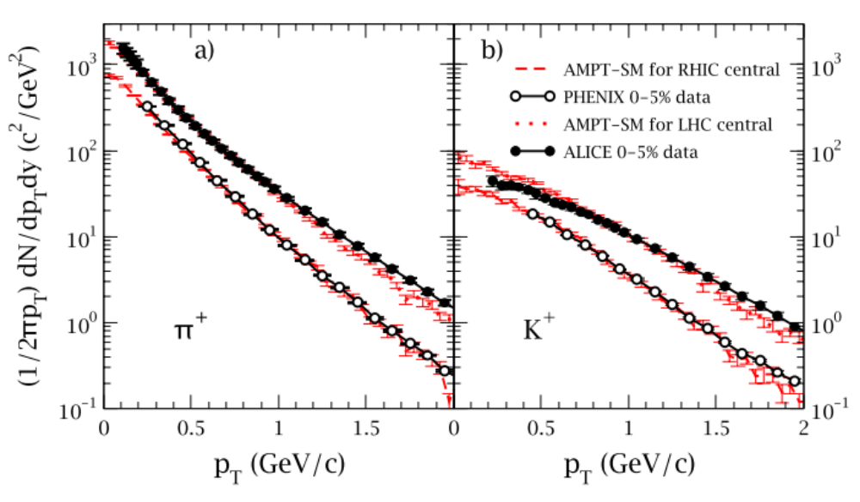
Selected results based on AMPT: new parameter set for String Melting
p_{T} -spectra of π & K (in central collisions):

Slide 31
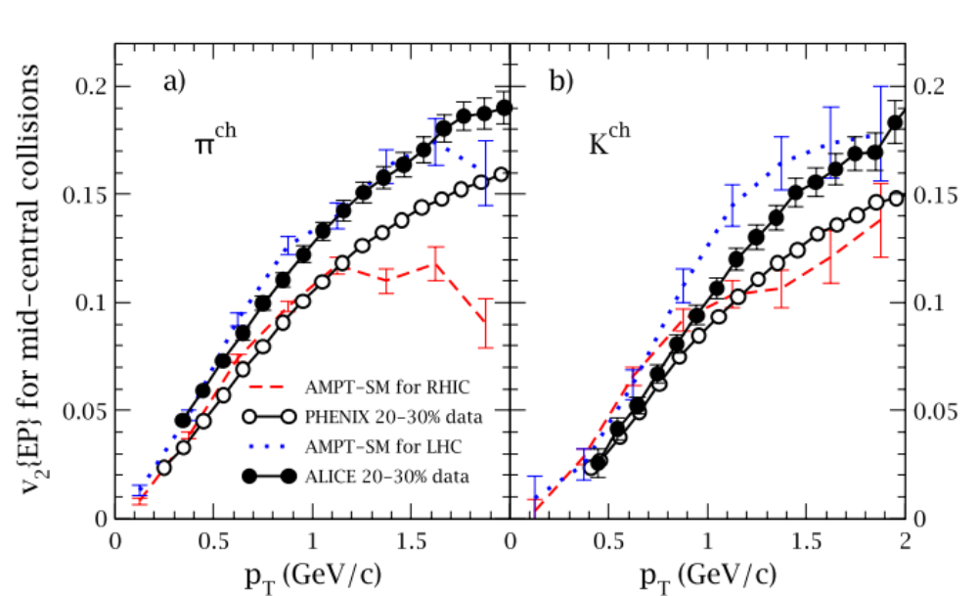
Selected results based on AMPT: new parameter set for String Melting
Suggest to use this parameter set
for string melting runs at RHIC/LHC
v2 of π & K (in mid-central collisions):

Slide 32
Selected results from AMPT: escape mechanism for v_{n}
Liang He, Terrence Edmonds, Zi-Wei Lin, Feng Liu, Denes Molnar, Fuqiang Wang:
arXiv:1502.05572v3:
Anisotropic parton escape is the dominant source of azimuthal anisotropy
in transport models
Also see my talk & P. Romatschke’s talk at QM2015
Current Paradigm for v_{n}
Early hydro-type collective flow in sQGP
converts initial spatial anisotropy into final momentum-space v_{n}
Transport models at large-enough cross section will approach hydrodynamics.
Since both hydrodynamics and transport models can describe v_{n} data,
it is generally believed: for low-P_{T} in high-energy heavy ion collisions,
the mechanism of v_{n} development in transport models (via particle interactions)
is in principle the same as in hydrodynamics (via pressure gradient).

Slide 33
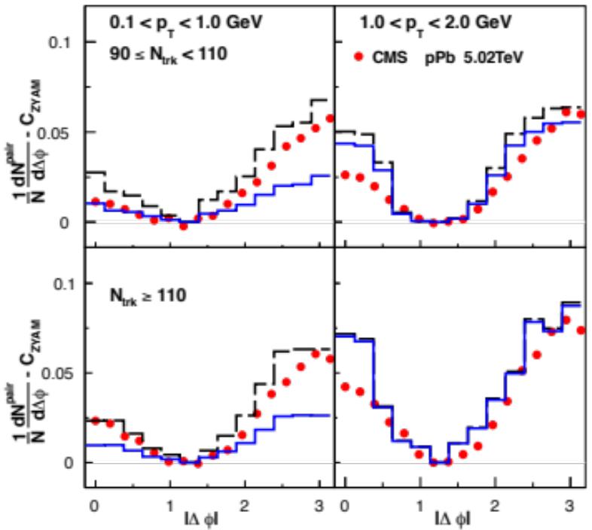
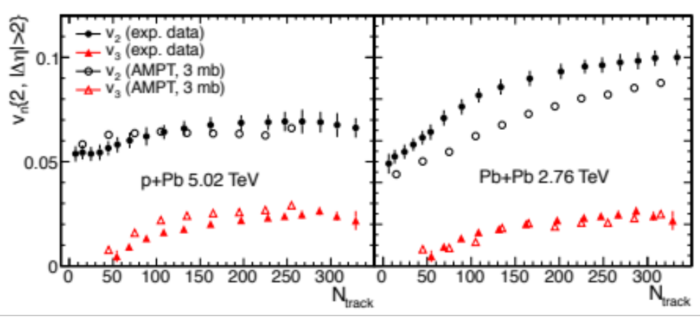
Selected results from AMPT: escape mechanism for v_{n}
Small systems: both hydrodynamics and transport can describe flow
Bzdak and Ma, PRL 113 (2014)
using AMPT (String Melting version).
Bozek and Broniowski, PLB 718 (2013)
using e-by-e viscous hydrodynamics.
Puzzle for small systems such as p+Pb or d+Au:
mean free path may be comparable to the system size;
is hydrodynamics still applicable to such small systems?

Slide 34
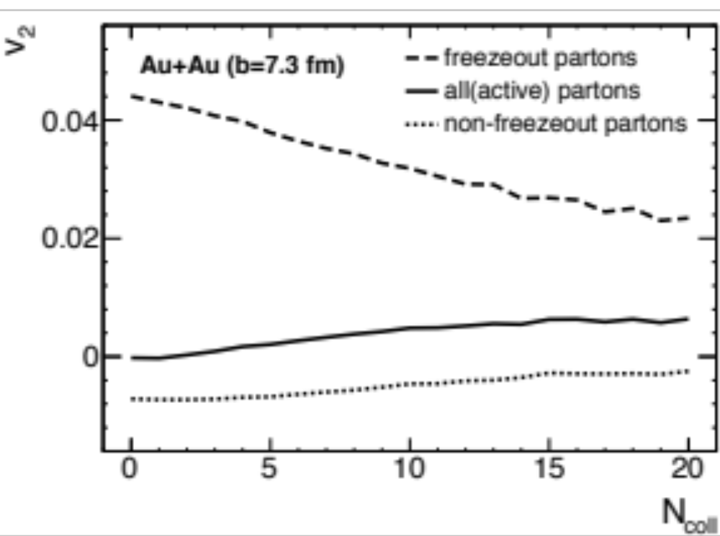
Selected results from AMPT: escape mechanism for v_{n}
Ncoll: number of collisions suffered by a parton
freezeout partons
all partons
active partons
3 parton populations at any given Ncoll:
freezeout partons: freeze out after exactly Ncoll collisions;
active partons: will collide further, freeze out after >Ncoll collisions;
all partons: sum of the above two populations
(i.e. all partons that have survived Ncoll collisions).

Slide 35
Selected results from AMPT: escape mechanism for v_{n}
At Ncoll=0:
all partons: v₂=0 by symmetry;
they contain 2 parts:
escaped/freezeout: v₂ ≈ 4.5%,
active: v₂ < 0.
freezeout partons
all partons
active partons
○
At Ncoll=1:
active partons at Ncoll=0
collide once each,
become
all partons at Ncoll=1: v₂ ≈ 0
○
○
This process repeats itself at higher Ncoll…

Slide 36
Selected results from AMPT: escape mechanism for v_{n}
At Ncoll=0:
escaped partons: v₂ ≈ 4.5%,
purely due to
anisotropic escape probability
(response to geometrical shape only,
no contribution from collective flow)
In simplified picture of elliptic flow
At Ncoll>=1:
escaped partons: v₂ > 0
due to
anisotropic escape probability
& (anisotropic) collective flow.
How to separate the two contributions?

Slide 37
Selected results from AMPT: escape mechanism for v_{n}
Final v₂ is generated by
interactions in presence of spatial anisotropy, which also generate (anisotropic) collective flow.
f(x,p,t)
Let’s view v₂ as coming from 2 separate but complimentary sources:
Pure escape (“the escape mechanism”):
v₂ from spatial anisotropy only
if there were 0 collective flow,
this is due to anisotropic escape probability.
2) Pure flow: v₂ from anisotropic collective flow only
    if there were no spatial anisotropy.
f(x,iso p,t)
f(iso x,p,t)
The two are coupled in the actual evolution,
so we design a Gedanken random-ϕ test to estimate contribution from 1):
we randomize ϕ after each parton scattering to destroy collective flow.
Notes:
1) Keep f(vec x) distribution but isotropic vec p distribution.
2) Keep f(vec p) distribution (i.e. including the fact that there are more partons going inplane) but symmetric vec x distribution.

Slide 38
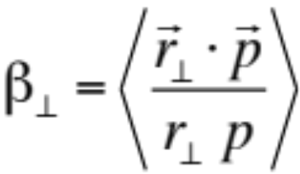
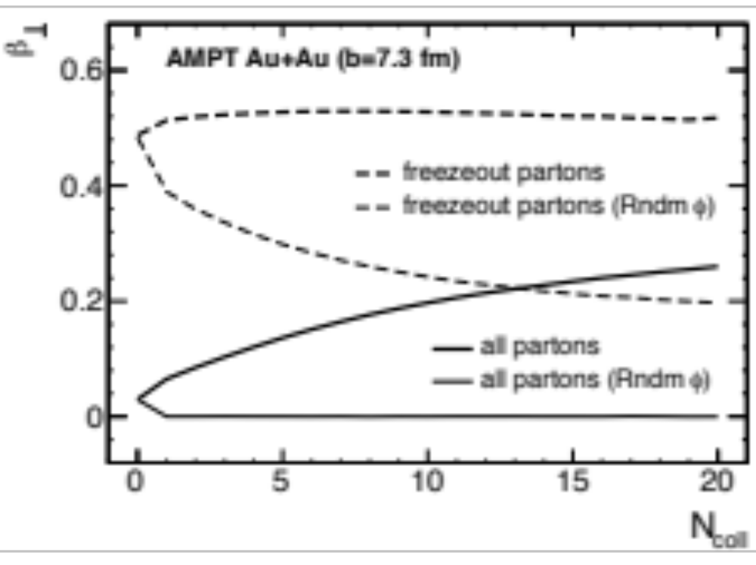
Selected results from AMPT: escape mechanism for v_{n}
reflects space-momentum correlation,
~ transverse flow velocity
Strong r-p correlation
~ Collective flow

Slide 39
Selected results from AMPT: escape mechanism for v_{n}
reflects space-momentum correlation,
~ transverse flow velocity
Strong r-p correlation
Random-ϕ test:
finite r-p correlation
r-p correlation
purely from
escape mechanism,
not from collective flow
~ Collective flow
Collective flow is destroyed
Notes:
Addition increase in the normal results from “all partons” to “freezeout partons”
is ~ from escape mechanism.
Collective flow is destroyed, as shown by the bottom curve.

Slide 40
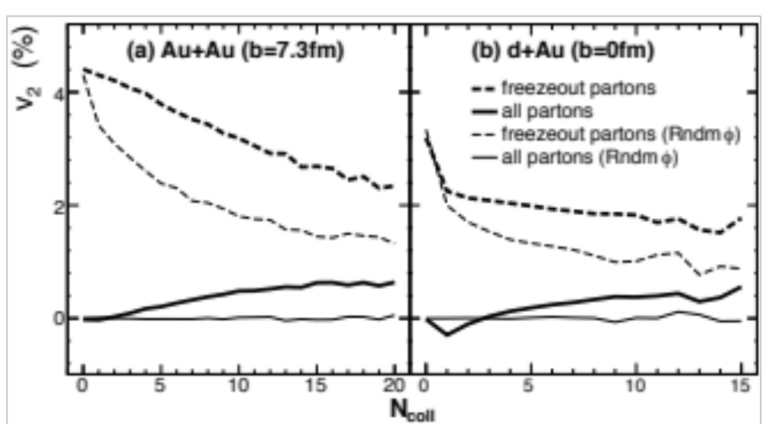
Selected results from AMPT: escape mechanism for v_{n}
v₂ from Random Test: purely from the escape mechanism
Normal AMPT
Random ϕ
Normal AMPT
Random ϕ
Normal <v₂> <v₂> for random-ϕ Ratio <Ncoll>
~ contribution from pure escape
Au+Au 3.9% 2.7% 69% 4.6 (modest)
d+Au 2.7% 2.5% 93% 1.2 (low)

Slide 41
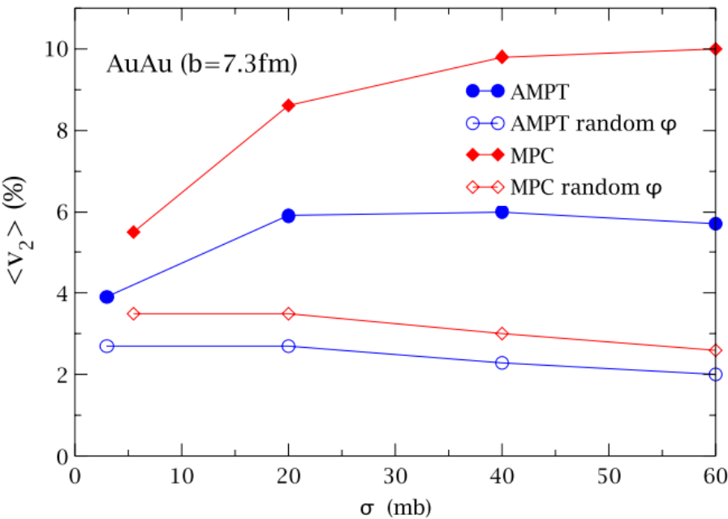
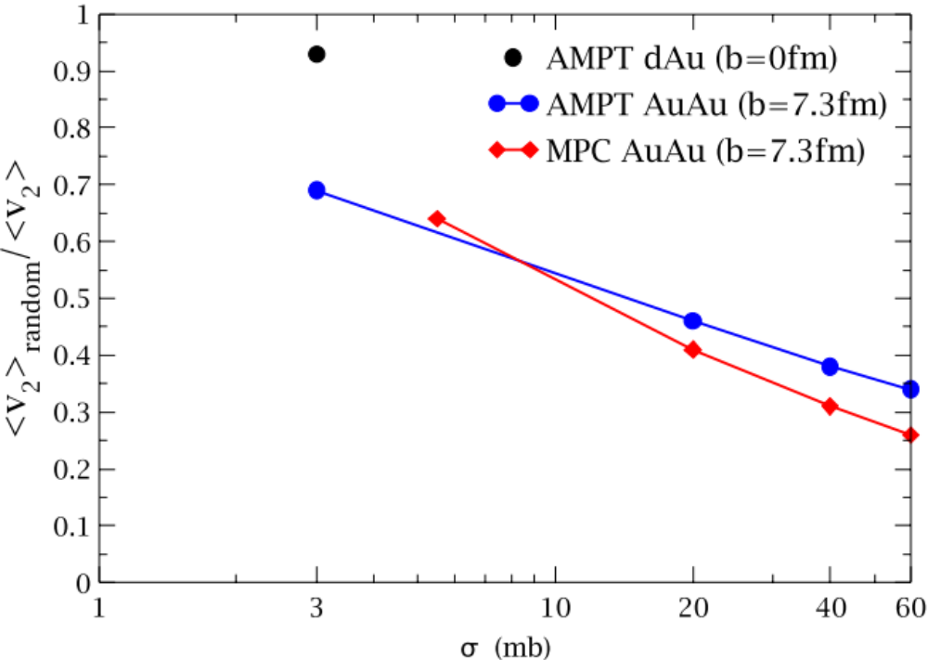
Selected results from AMPT: escape mechanism for v_{n}
v₂ Ratio
MPC: the same qualitative conclusion as AMPT
despite many differences
(parton initial condition,
cross section & dσ/dt,
formation time,
parton-subdivision)
Anisotropic particle escape
is dominant contribution of v₂ for small systems
& even for semi-central AuAu at RHIC
At very large σ or <Ncoll>,
hydrodynamic collective flow
will be the dominant contribution of v₂
Notes:
“maybe” refers to the possibility that the coupling between v2(1: pure anisotropic escape) and v2(2:pure anisotropic collective flow) may not be linear.
If quadratic, then each may contribute to 71% of final v2 separately.

Slide 42
Selected results from AMPT: escape mechanism for v_{n}
The escape mechanism helps to explain similar anisotropic flows
observed in small and large systems:
since both are dominated by same mechanism (anisotropic escape probability)
The driving force for v₂ at low & high P_{T} is qualitatively the same
since both are dominated by anisotropic probability of interactions before escape
(scatterings for low P_{T} & energy loss for high P_{T})
At low/modest opacity/<Ncoll>: transport and hydrodynamics are different.
The escape mechanism dominates v_{n} at low to modest opacity/<Ncoll>;
hydro-type collective flow dominates v_{n} at very high opacity/<Ncoll>:
which is the case for AA collisions?
which is case for pp or pA collisions?

Slide 43
Challenges and opportunities: 1
with C. Greiner
1) Fix charge conservation in AMPT
to enable AMPT for studies of charge fluctuations and other charge observables.
Why is charge conservation violated in hadron cascade of AMPT?
First reason:
The hadron cascade has K⁺ and K⁻ as explicit particles,
but not K⁰ and K⁰-bar;
so we have made conversions between K⁰/K⁰-bar and K⁺/K⁻ ➔Violation
Second reason:
Some reactions in hadron cascade
are not implemented explicitly for every possible configuration of isospin/charge:
final state particles have randomly-generated isospin.
Notes:
isospin-averaged cross section is used

Slide 44
Challenges and opportunities: 2
2) Develop parton recombination in the transport model approach
The dynamical quark coalescence in AMPT
respects quark number conservation (important below a moderate P_{T}),
this is different from the usual perturbative formulation
this unitarity constraint leads to a linear quark-hadron scaling at low P_{T}
(not NCQ Number-of-Constituent-Quark scaling):
e.g. v_{2,M}(P_{T})=1*v_{2,q}(P_{T}/NCQ) if only forming mesons.
ZWL, JPG 38 (2011)
But currently quark coalescence in AMPT only considers relative distance.
We need to further develop the hadronization model in AMPT, e.g.
quark coalescence / parton recombination in phase-space
(considering both relative distance and relative momentum)
start quark coalescence
around a critical energy density ~ε_{c} (onset of confinement),
not simply after the parton’s kinetic freeze-out.
Notes:
Also need to treat partons that do not find partners; they are expected to be high-pt partons typically.

Slide 45
Challenges and opportunities: 3
3) Include gluons and inelastic parton reactions
How to include gluon productions
in addition to quark production in string melting initial condition?
Include inelastic parton reactions:
gg <-> qqbar / ssbar / ccbar, 2 <->3
Improve parton recombination in a transport approach:
  How to include gluons?
  Is there an entropy problem?
  New quark-hadron scaling for the bulk.
  Will extend AMPT to intermediate P_{T} region.
4) Up-to-date PDF:
Replace Duke-Owens parton distribution function
Important for heavy flavors and high-P_{T}.
5) High P_{T}:
Energy loss and independent fragmentation for fast partons
  Will extend AMPT to the high P_{T} region.
Notes:
Also need to treat partons that do not find partners; they are expected to be high-pt partons typically.

Slide 46
Summary
AMPT serves as a comprehensive model for heavy ion collisions:
event-by-event from initial condition to final observables
String Melting introduces additional fluctuations and correlations
Can address non-equilibrium dynamics
It is a test-bed of different ideas & can lead to new discoveries:
Example: v₂ may be dominated by anisotropic escape
  instead of hydrodynamics flow due to low & modest opacity,
  this naturally explains similar v2 & v3 for small & large systems
  but challenges the “Perfect Fluid” paradigm.
Further developments are needed and overdue:
Fix charge conservation in hadron cascade
  Improve parton recombination
  Include gluons and inelastic parton reactions
  Up-to-date PDF
  High P_{T}

Slide 47
Extra Slides

Slide 48


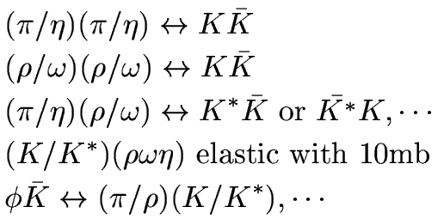
Meson-Meson channels
Individual components of AMPT: hadron cascade
SU(2):
With strangeness:

Slide 49
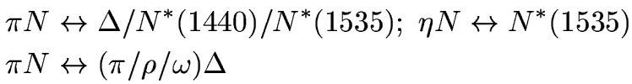
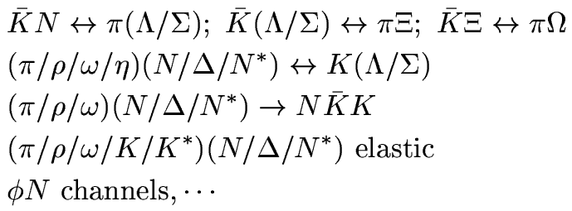


Meson-Baryon & Baryon-Baryon channels
Individual components of AMPT: hadron cascade

Slide 50
Maintenance and developments of AMPT: source codes
Package of each AMPT version includes:
amptsub.f
art1f.f
hijing1.383_ampt.f
hipyset1.35.f
linana.f
main.f
zpc.f
README
Makefile
exec
input.ampt
ana/
Fortran source routines
Users’ Guide
(including summary of changes)
Script to run AMPT
Input parameter settings
Directory for output data and diagnostics files

Slide 51
Maintenance and developments of AMPT: input file input.ampt
200. ! EFRM (sqrt(S_NN) in GeV if FRAME is CMS)
CMS ! FRAME
A ! PROJ
A ! TARG
197 ! IAP (projectile A number)
79 ! IZP (projectile Z number)
197 ! IAT (target A number)
79 ! IZT (target Z number)
1 ! NEVNT (total number of events)
7.3 ! BMIN (mininum impact parameter in fm)
7.3 ! BMAX (maximum impact parameter in fm, also see below)
4 ! ISOFT (D=1): select Default AMPT or String Melting(see below)
150 ! NTMAX: number of timesteps (D=150), see below
0.2 ! DT: timestep in fm (hadron cascade time= DT*NTMAX) (D=0.2)
0.55 ! PARJ(41): parameter a in Lund symmetric splitting function
0.15 ! PARJ(42): parameter b in Lund symmetric splitting function
1 ! (D=1,yes;0,no) flag for popcorn mechanism(netbaryon stopping)
1.0 ! PARJ(5) to control BMBbar vs BBbar in popcorn (D=1.0)
1 ! shadowing flag (Default=1,yes; 0,no)
0 ! quenching flag (D=0,no; 1,yes)
2.0 ! quenching parameter -dE/dx (GeV/fm) in case quenching flag=1
2.0 ! p0 cutoff in HIJING for minijet productions (D=2.0)
2.265d0 ! parton screening mass in fm^(-1) (D=3.2264d0), see below
0 ! IZPC: (D=0 forward-angle parton scatterings; 100,isotropic)
0.33d0 ! alpha in parton cascade
1d6 ! dpcoal in GeV
1d6 ! drcoal in fm
……
3 ! optional OSCAR output (D=0,no; 1,yes; 2&3,more parton info)
……
0 ! Flag to enable users to modify shadowing (D=0,no; 1,yes)
0.d0 ! Factor used to modify nuclear shadowing
Collision parameters/
HIJING/fragmentation
Hadron Cascade
(e.g. NTMAX=2 turns off
hadron cascade
but still has full parton cascade & hadronization)
Parton Cascade
Coalescence radii (N/A)
Output option
Option to modify shadowing

Slide 52
Maintenance and developments of AMPT: input file input.ampt
%%%%%%%%%% Further explanations:
……
ISOFT: 1 Default,
4 String Melting.
……
NTMAX: number of time-steps for hadron cascade.
Use a large value (e.g. 1000) for HBT studies in heavy ion collisions.
Using NTMAX=3 effectively turns off hadronic cascade.
parton screening mass (in 1/fm): its square is inversely proportional to
the parton cross section. Use D=3.2264d0 for 3mb cross section
and 2.2814d0 for 6mb (when alpha in parton cascade is set to 0.47).
Using 1d4 effectively turns off parton cascade.
……
%%%%%%%%%% User modification of nuclear shadowing:
ishadow: set to 1 to enable users to adjust nuclear shadowing
provided the shadowing flag IHPR2(6) is turned on; default value is 0.
dshadow: valid when ishadow=1; this parameter modifies the HIJING shadowing
parameterization Ra(x,r)==1+fa(x,r) via Ra(x,r)==1+fa(x,r)*dshadow,
so the value of 0.d0 turns off shadowing
and the value of 1.d0 uses the default HIJING shadowing;
currently limited to 0.d0<=dshadow<=1.d0 to make sure Ra(x,r)>0.

Slide 53
Maintenance and developments of AMPT: output file ampt.dat
Npart1_el
Event#
Particle#
b(fm)
Npart2_el
Test#
Npart1_inel
Npart2_inel
1 1 4184 7.3000 108 96 5 103 5 91 0.0000
2112 0.000 0.000 99.9956 0.940 4.57 -6.00 0.20 0.20
2112 0.000 0.000 99.9956 0.940 7.33 1.94 0.20 0.20
2112 0.000 0.000 99.9956 0.940 5.31 2.87 0.20 0.20
2112 0.000 0.000 99.9956 0.940 4.94 -0.11 0.20 0.20
2112 0.000 0.000 -99.9956 0.940 -8.24 0.20 -0.20 0.20
Particle ID
(PYTHIA)
Final momentum
mass
Final position & time
(at kinetic freeze-out)
Notes:
Last value is the angle when random orientation of reaction plane is enabled.

Slide 54
Maintenance and developments of AMPT: output file zpc.dat
Npart1_el
Npart2_el
Particle#
Npart1_inel
Npart2_inel
b(fm)
EventIteration#
Event#
1 2 442 8.0000 2 82 1 83
21 0.368 2.459 -6.880 0.000 0.85 2.98 -6.79 7.16
21 6.456 -1.633 1.884 0.000 2.60 2.81 0.18 0.68
For default
model:
Particle ID
(PYTHIA)
Final momentum
mass
Final position & time
(at kinetic freeze-out)
For string
melting model:
1 0 5492 7.3000 5 103 5 91
1 -0.842 1.584 -0.264 0.010 -1.47 5.04 -0.26 1.94
1 -0.304 -0.942 -1.188 0.010 -1.54 1.86 -2.12 3.63

Slide 55
Maintenance and developments of AMPT: readme 3
Examples (from the readme file):
4/2012 test version v1.25t7d/v2.25t7d:
* Modified format of ana/npart-xy.dat:
write impact parameter at the end of the first line of each event;
events in npart-xy.dat correspond to those in ana/ampt.dat (in that
now events that eventually failed fragmentation and thus get repeated
are not written to ana/npart-xy.dat).
9/2011 test version v1.25t7/v2.25t7:
* added Pt tolerance etc to determining spectator nucleons consistently,
this is found to only affect string melting runs when LAB frame is used
(in that 1: npart values in ampt.dat are now correct and
2: the run will not generate incorrect events that have no particles)

Slide 56
Maintenance and developments of AMPT: readme 2
Examples (from the readme file):
12/19/2012 test version v1.26t2/v2.26t2:
* Modified format of ana/npart-xy.dat:
added last 2 columns on the present and original flavor code of nucleon.
* Corrected original nucleon flavor in the calculation of NN differential
cross sections in HIJING.
9/2012 test version v1.26t1/v2.26t1:
* Use double precision in art1f.f when calculating sqrt(s) to avoid crash
(segmentation fault due to s<0) at high energy such as LHC at large NT;
also use double precision in linana.f to calculate beta to avoid NaN.
* Use a more general formula in amptsub.f to calculate rapidity
(valid for hadrons at large rapidities that have |Pz|>=E
due to finite precision)

Slide 57
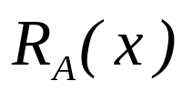
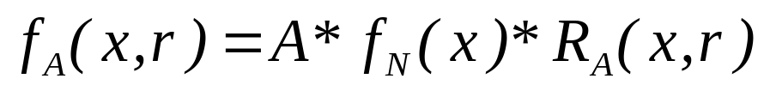
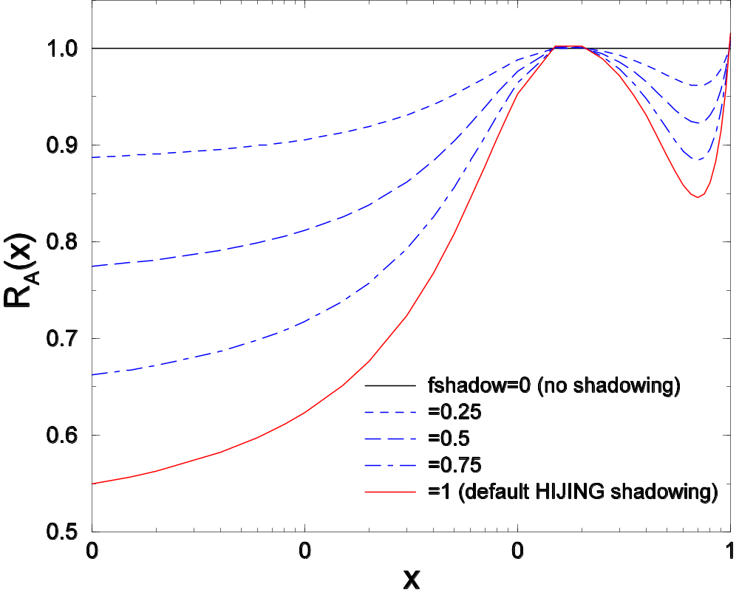
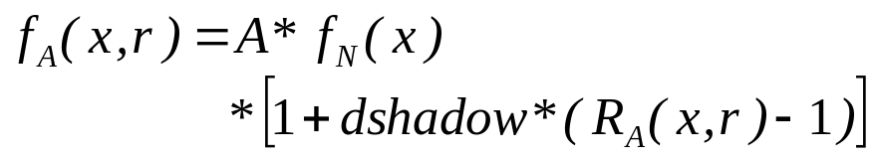
Maintenance and developments of AMPT: example
Example: option to enable users to modify nuclear shadowing
Nucleon’s position in a nucleus
Position-averaged shadowing function
Users can modify nuclear shadowing by
dshadow=0: no-shadowing
dshadow=1: default HIJING shadowing
Currently require
0.d0≤ dshadow ≤1.d0
to ensure R_{A}(x,r)≥0

Slide 58
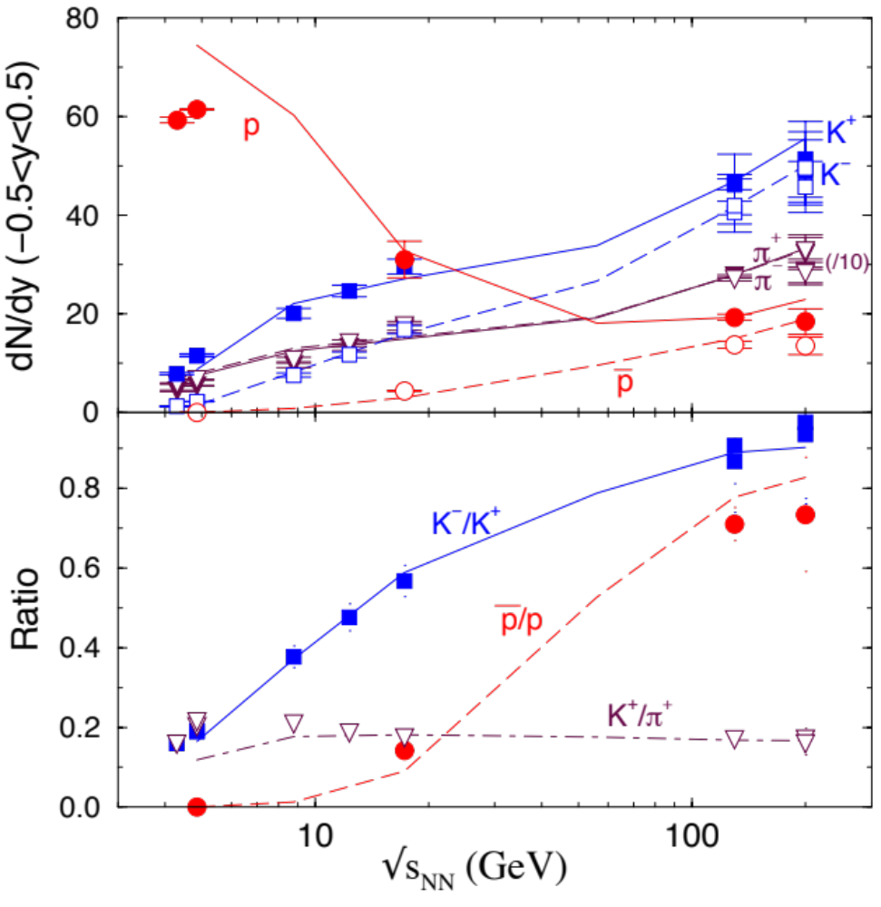
Selected early results from AMPT
Particle yields
from AGS to
RHIC energies
ZWL et al. PRC72
Notes:
Present status

Slide 59
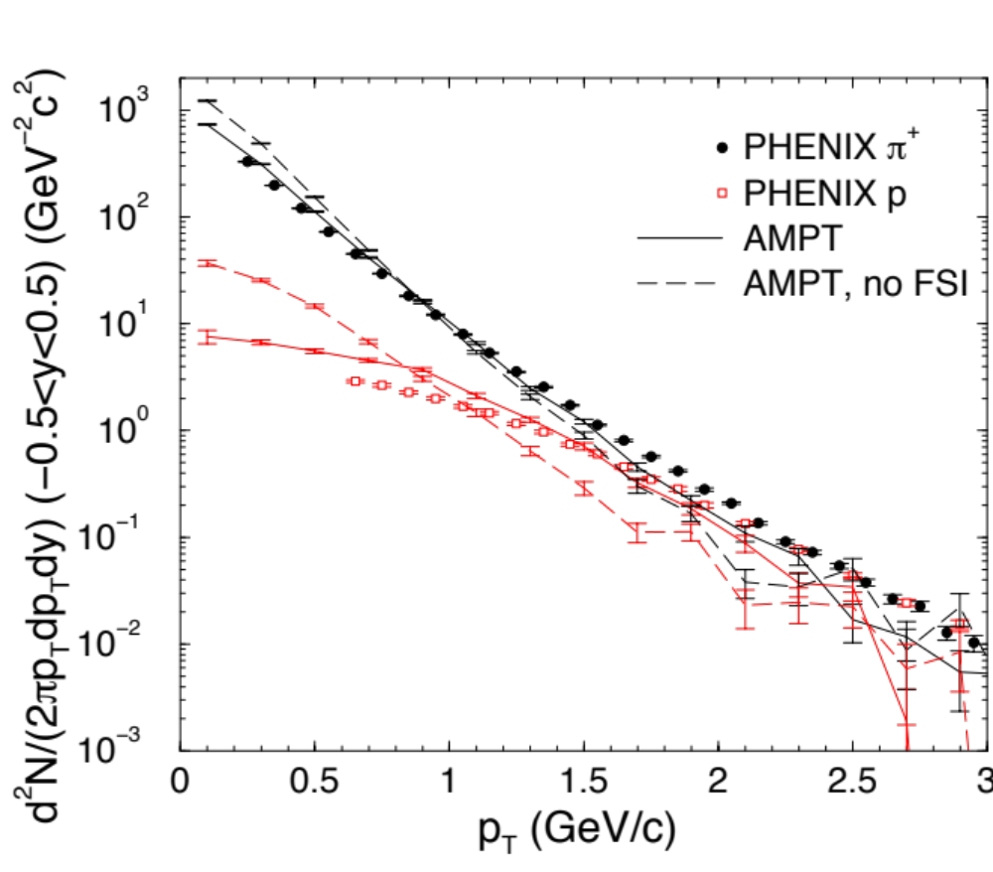
Selected early results from AMPT
FSI
=Final State Interactions:
lead to
more transverse flow.
ZWL et al. PRC72
Notes:
Present status

Slide 60
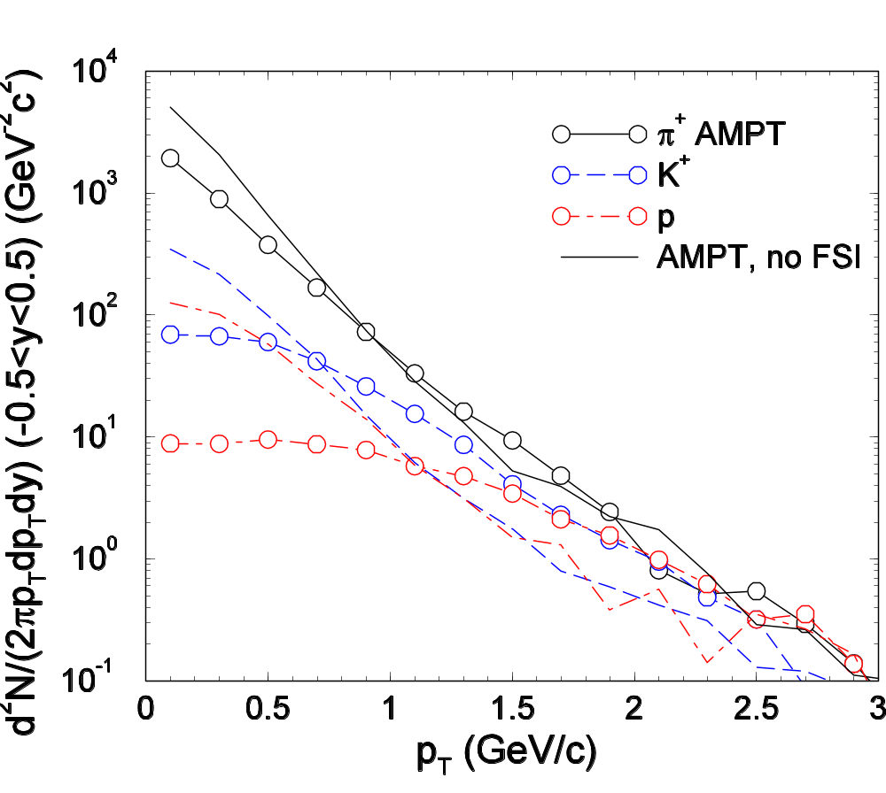
Selected early results from AMPT
Central (b<3 fm) Pb+Pb collisions at 5500 AGeV
default AMPT model v1.11
from AMPT long paper (PRC72, 064901, 2005)
Final state (partonic and hadronic) interactions leads to transverse flow (stronger than at RHIC)

Slide 61
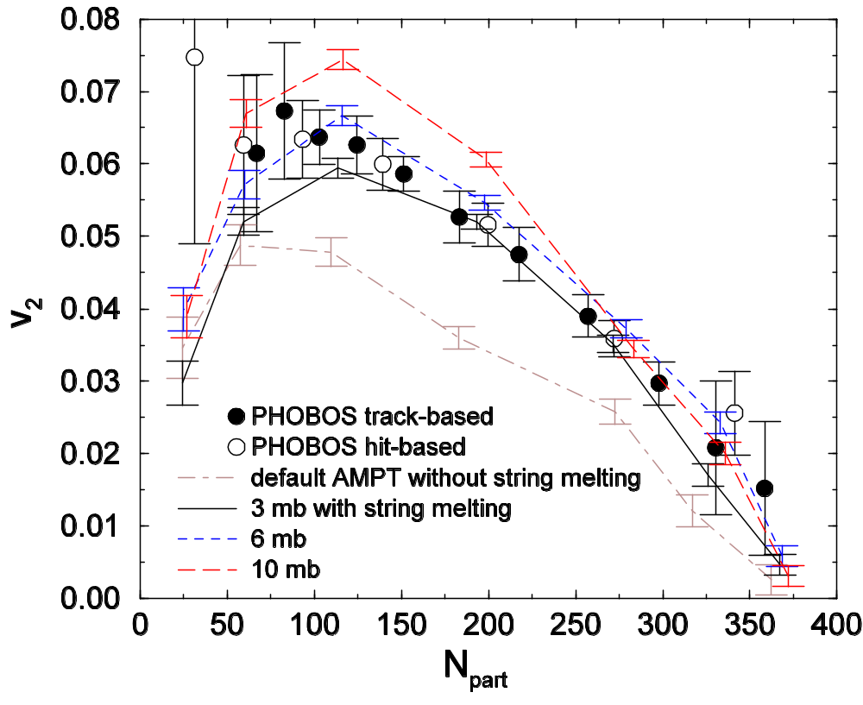
Selected early results from AMPT
Elliptic flow v₂ at RHIC
Au+Au collisions@200 AGeV
String Melting in AMPT:
if strings “melt” to partons,
partonic interactions are
strong enough to produce v₂
ZWL & Ko, PRC65;
ZWL et al. PRC72

Slide 62

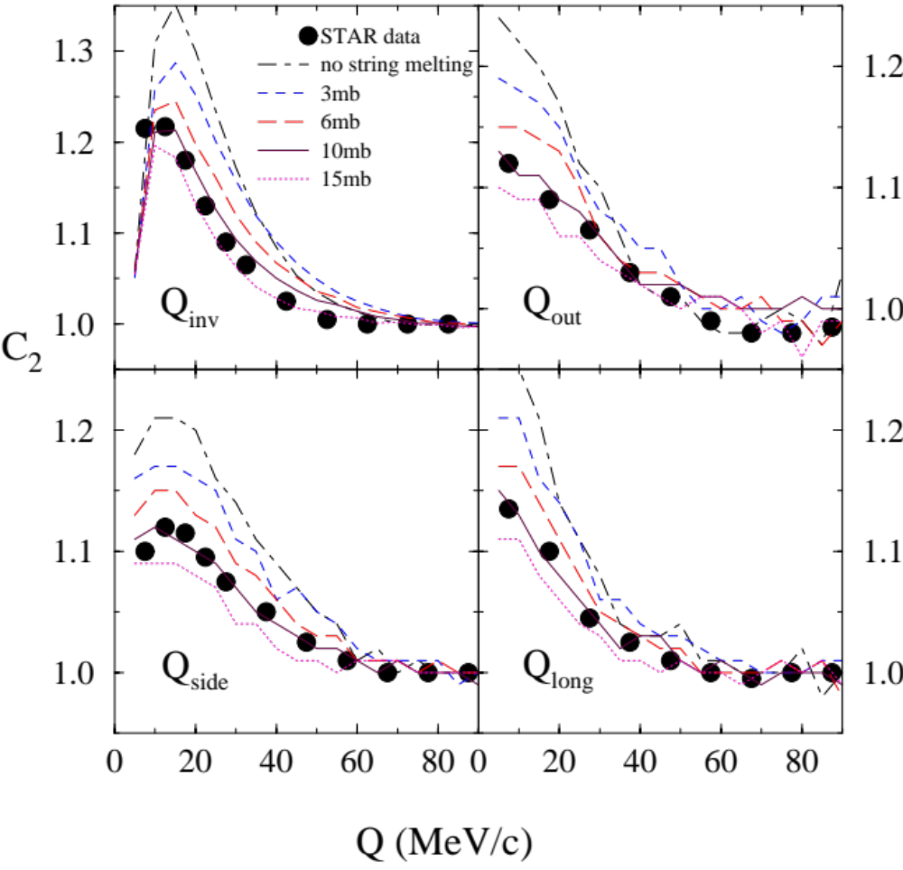
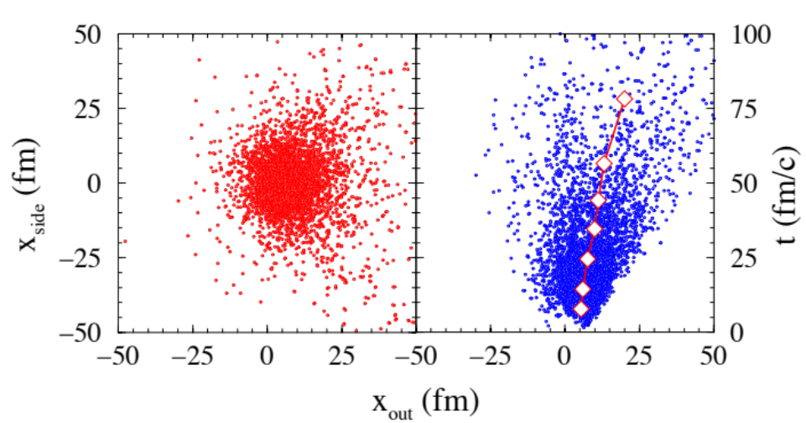
Selected early results from AMPT
AMPT can roughly reproduce
the RHIC HBT radius values
Pion interferometry at RHIC
A transport model is needed to
describe the non-equilibrium
kinetic freeze-out process:
ZWL, Ko & Pal, PRL79
Notes:
Details of the Hanbury Brown–Twiss correlations can be seen using source functions, and there one can see the discrepancies between AMPT and the data. See Lin JPG35 (2010).

Slide 63
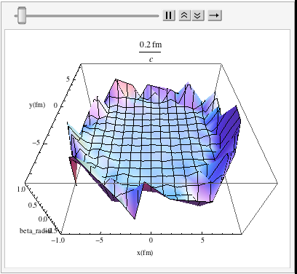

Selected results from AMPT: 1
Flow in a cell is defined as
Transverse flow
in RHIC central:
the transverse plane
at 1 fm resolution:
X
X
This study averages over
many events
(for the same collision system at the same centrality);
thus e-by-e fluctuations
are neglected

Slide 64
Summary
AMPT serves as a comprehensive model for heavy ion collisions:
event-by-event from initial condition to final observables
String Melting introduces additional fluctuations and correlations
pre-equilibrium dynamics is modeled by elastic parton cascade
a test-bed of different ideas, can lead to new discoveries.
Further developments are needed and overdue:
Fix charge conservation in hadron cascade
  Develop event-by-event String Melting
  Improve dynamical parton recombination
Thank you!

Slide 65
Challenges and opportunities
Fix charge conservation in AMPT
Hadronization
Why is charge conservation violated in AMPT?
First reason:
The hadron cascade
has K⁺ and K⁻ as explicit particles,
but not K⁰ and K⁰-bar.
K⁰ K⁺
K⁻ K⁰-bar
K⁺
K⁻
To let all kaons interact:
before hadron cascade,
we change K⁰ to K⁺ (also: K⁰-bar to K⁻)
after hadron cascade,
we change half of final K⁺ into K⁰.
Hadron cascade
K⁺
K⁻
K⁰ K⁺
K⁻ K⁰-bar

Slide 66



Fix charge conservation in AMPT
Why is charge conservation violated in AMPT?
Second reason:
Many reactions in the hadron cascade
are not implemented for each possible isospin configuration:
isospin-averaged cross section is used,
final state particles have randomly-generated isospin.
For example: for
each final-state pion could have +, 0, – charge in AMPT:
so we can have or
allowed should be forbidden

Slide 67
Fix charge conservation in AMPT
We need to:
add K⁰ & K⁰-bar as explicit particles,
allow similar interaction types as for K⁺ & K⁻.
Several steps:
1) Forbid final states that violate charge conservation: this is enough to conserve charge.
2) Update/determine cross sections of allowed final states
including the branching ratios
3) Check detailed balance among related cross sections
Hadronization
K⁰ K⁺ K⁰-bar K⁻
Hadron cascade
(w/ full isospin)
K⁰ K⁺ K⁰-bar K⁻
Requires checking essentially all hadron reactions in AMPT

Slide 68

Challenges and opportunities
Challenges and opportunities: 3
3) Develop dynamical quark coalescence/parton recombination
Currently, a parton can coalesce after kinetic freeze-out
(i.e. after it will not have further interactions)
➔Average parton density at coalescence
is too low (<< ε_{c} ~ 1/2 GeV/fm³),
& it depends on parton cross section σ_{p}
Hadronization reflects
the onset of confinement:
➔start quark coalescence around
a critical energy density ~ε_{c}
➔Expect quark coalescence to work better
due to the much higher density
Zhang, Chen & Ko, JPG 35
Notes:
Coalesce needs to be done in phase-space (x-p) instead of only in x. Fragmentation of leftover partons (typically high-Pt).

Slide 69
Challenges and opportunities: 2
When initial energy density in a collision
> energy density for QCD phase transition ε_{c} :
Onset of deconfinement
➔strings should not exist,
instead the energy should be in partonic matter.
➔ The String Melting version of AMPT
6) Develop
event-by-event String Melting
From Proposal to DOE in 2010:
“Currently, one has to .. choose whether the default version or the string melting version
of AMPT should be used for a given configuration of heavy ion collisions…
furthermore, these choices are made independent of the centrality of the collisions.
However, … a consistent activation of string melting should depend on the initial local energy densities right after the collisions of the two nuclei.
In this proposal, I plan to develop consistent initial states for the evolution of the dense matter.
…the AMPT model will be able to self-consistently determine, on event-by-event basis according to both the energy and the centrality of a heavy ion collision, whether the initial state should be string-dominated or parton-dominated”.
This will lead to additional event-by-event fluctuations,
especially in collision systems near the phase transition line.
Notes:
Hadrons formed via coalescence do not include eta’ in pseudoscalar mesons, Sigma* or Xi* in decuplet baryons.

Slide 70

Maintenance and developments of AMPT: webpage
http:// myweb.ecu.edu/linz/ampt

Slide 71



Selected results from AMPT: effective temperature
Central Au+Au
@ 200A GeV
The effective temperatures are different
non-equilibrium local parton system
For this center cell:

Slide 72


Selected results from AMPT: effective temperature
is true for the center cell of all 4 collision systems:
Notes:
Relation for Te is good within 6% in the dense phase (T>100MeV).
So we will focus on Te and T<pt> now, not Tn.

Slide 73



Selected results from AMPT: effective temperature
for the inner part of the overlap volume
Energy and number densities ε, n are too high, relative to the expected values
for an ideal QGP at temperature (with same <p_{T}> as partons in the cell).
The local parton system is over-populated.

